Slide 1

Child Passenger Safety Training
For Tribal Law Enforcement Officers
BERNADINE PHILLIPS,
NATIVE CARS SITE COORDINATOR, CPST
Notes:
Hello, I am Bernadine Phillips, I am the Colville Native CARS Site Coordinator. I am also a Child Passenger Safety Technician. During the Native CARS project several interventions were implemented. Passing a Colville Tribal Law Enforcement Child Restraint code was supported by participants . In August 2011 a Child Restraint Code was passed., Since then a Law Enforcement training was developed.
The presentation is designed for Tribal Law Enforcement Officers and the importance of their Role in Child Passenger Safety.
There are three parts in this presentation
Part One will give an overview of Crash dynamics and why car seats and seat belts help keep children secure in a vehicle.

Slide 2
Pretest
Notes:
In the original law enforcement training a pretest was conducted. This was designed to determine how much you know at the beginning of the course and later how much youi have learned after the course. There is a link on the screen that will take you to the pretest.

Slide 3
Securing Our Future
Video: Securing Our Future,
Native American Child Passenger Safety
Video introduces the participants to the basic overview of child passenger safety while addressing issuers that are unique to Native American communities.
Notes:
The video Securing our Future, Native American Child Passenger Safety introduces the paricipants to the basic overview of child pasengeer safety while addressing issues that are unique to Native American communites. The video is about 12 minutes long

Slide 4
The Learn, Practice, Explain Model
LEARN
PRACTICE
EXPLAIN
TELL
SHOW
DO
Notes:
The emphasis in this course is places on ensuring that your learning experience will successfully prepare you to achieve the main purpose-to help caregivers safely transport their families.
So this course has been designed using the Learn, Practice, Explain Model.
In Law Enforcement training, you probably use the “Tell, Show, Do” model. .
Learn(Tell)-learn the facts/skills/information. Seek ways to stay updated. (CPS information is often updated), Then
Practice (Show)-you new skills and share information.
Explain (Do)-(teach) what you have learned to caregivers and drivers.

Slide 5
Crash Injuries
Fatal injuries remain the leading cause of death for American Indians 1-44 years of age
For US American Indian children 1-19 years, injuries accounted for 82% of all deaths in 2007
American Indian/Alaskan Natives experienced the highest motor vehicle related deaths than any other race or ethnicity
American Indian/Alaskan Native children 0-8 experience motor vehicle injury-related mortality rates twice the rate of Non-Hispanic whites.
Most motor vehicle fatalities occur within 10 miles or less from home.
Notes:
According to the Centers for Disease Control and Prevention: www.cdc.gov/ncipc/wisqars/
motor vehicle crashes are the leading cause of death for Native Americans ages 1-44.
In addition, more Native American children, ages 1-16, die from motor vehicle crashes than from any other cause.
Most motor vehicle fatalities occur within 10 miles or less from home

Slide 6
Fatalities Are Just the Tip of the Iceberg
You Can’t Survive Every Crash
Some crashes are too violent to survive
Many factors determine outcome
Restraints and airbags give the best chance of survival
Notes:
Deaths from crashes are only the tip of the iceberg. There are many more injuries than deaths every year. A lot of times you could ask some older people, and they could tell you that a facial scar or disfigurement was from a car crash, where they might have hit the dash of door, or other part of the car.
For every child who dies from an injury, many others are put in the hospital. And even more need care in emergency rooms, clinics and doctors’ offices.
Some injuries are very serious and can change a child’s life forever.

Slide 7
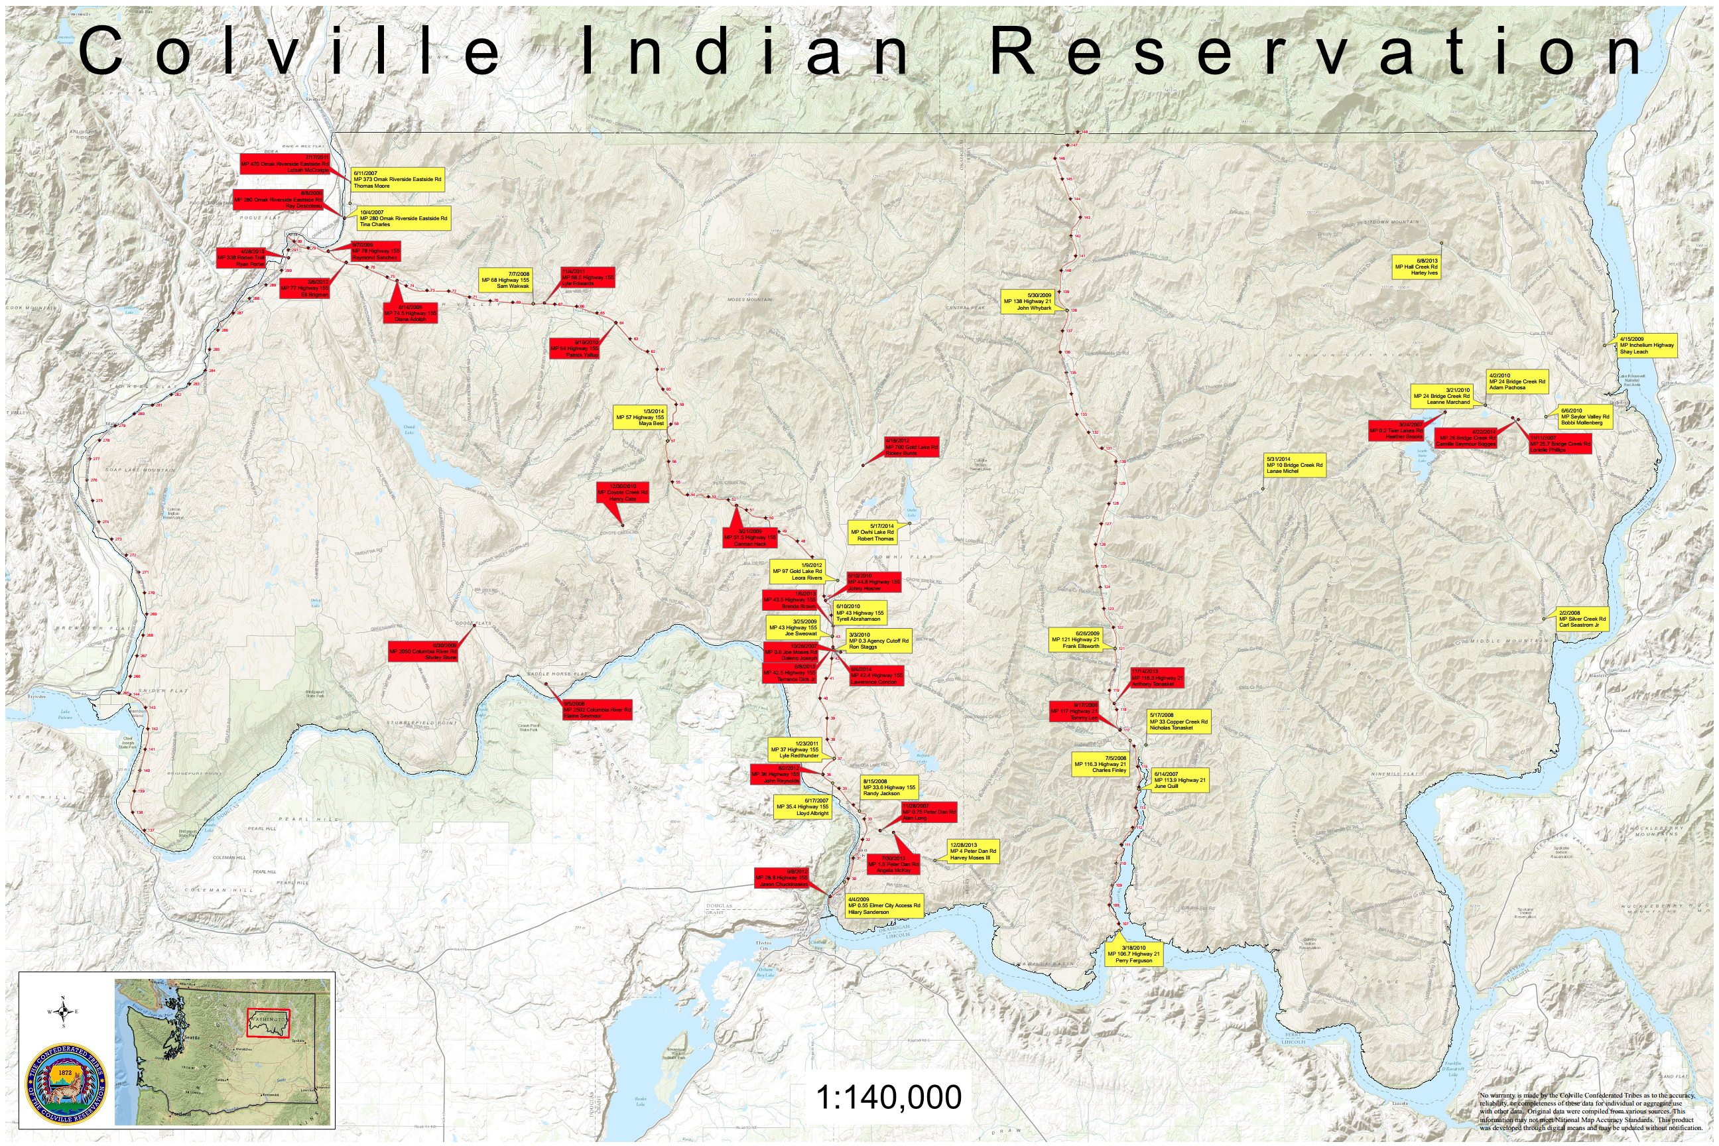
Colville Vehicle Crashes & Fatalities
Notes:
This map of the Colville Indian Reservation shows the locations of different car crashes on the Colville Reservation from 2007-2014. The yellow markers are crashes with injuries, and the red markers show crashes where there were fatalities. Almost every reservation has a road or location where there have been a lot of car crashes.
You may be able to find similar information for your tribe or community. It is helpful to understand where crashes are occurring.

Slide 8
Challenges To Crash Survival
Non-use of restraints
Misuse of restraints
Use decreases as children get older
Outdated or incorrect educational materials
Notes:
What are challenges to surviving a crash?
Non-use of CRs/safety belts remain a problem, especially in Native American communities. You can help educate your community about CR and seatbelt use.
Misuse rates vary from 73% to over 90%. In some Native American communities misuse rates are even higher. Correct installation and use of a CR can sometimes be difficult and leads to misuse.
Studies show that correct restraint use drops as children get older. Most children are restrained during the first year of life because they appear to be more fragile and need more protection. However, there is a drop in use for children from 1 to 3 years of age and a bigger drop from 4 to 7. This age group is seen as too big for a CR yet too small for seat belts alone.
It is important to review educational materials every year to be sure you are providing accurate and current information. By understanding correct use of CRs and seatbelts, it will be easy to see misuse and offer education to correct it.

Slide 9
Why Restrain Children?
Larger head
High center of gravity
Smaller body
Soft skull bones
Rounded hip bones
Weak stomach muscles
Vehicles and seat belts are built for adults
Notes:
Children tend to have larger heads, so they have a higher center of gravity. Their bodies are smaller in proportion to their heads. . Their bones are softer, and the hips are more rounded. Stomach muscles are weaker, Vehicles and seat belts are designed for adults, so they will not fit a child like they would an adult:
These make it more important to buckle up children.
Vehicles are not built for kids. Most safety features in vehicles are built with adults in mind. Therefore, children are at greater risk of getting hurt than adultswhen they are not properly restrained.

Slide 10
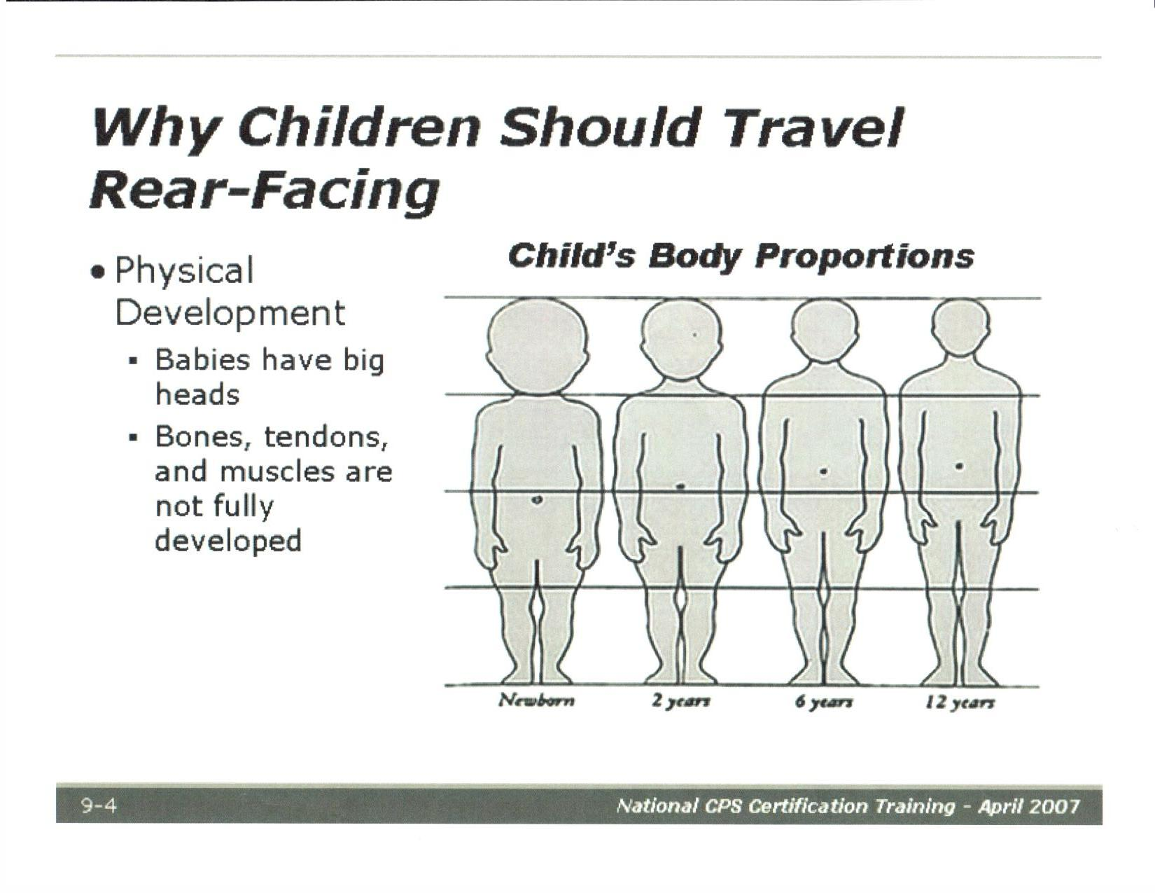
Notes:
This slide shows the proportions of an infant to a 12 year old child. you can see that the infant has a larger head than the 12 year old child.

Slide 11
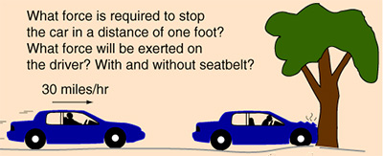
Crash Forces Explained
Weight X Speed = Restraining Force
10 lb. x 30 mph = 300 lbs
Notes:
One way to help the public understand crash forces is to explain that the strength needed to restrain a person roughly equals the weight of the person times the vehicle speed.
For example: A 10 lb. infant in a motor vehicle moving at 30 MPH would require at least 300 lbs. of strength to keep from moving forward.
It is important for parents/caregivers to understand that holding a child in their lap or unrestrained is dangerous to the child.
Can you hold 300 pounds? Now imagine an adult at a higher weight at the same speed.

Slide 12
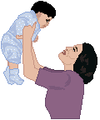
What Collides in a Crash
Vehicle
People
Inside the body
Notes:
A quick change in speed is what causes people to get hurt.
There are three collisions which happen in a crash:
First, the vehicle hits an object such as a tree or another vehicle.
Second, the people in the vehicle hit the inside of the vehicle, each other, or other loose items in the vehicle.
Third, the organs inside a person’s body may hit other organs, bones, or even the inside of the skull. The person may look fine but the brain, heart, or other organs may be torn, bruised, or bleeding inside.

Slide 13
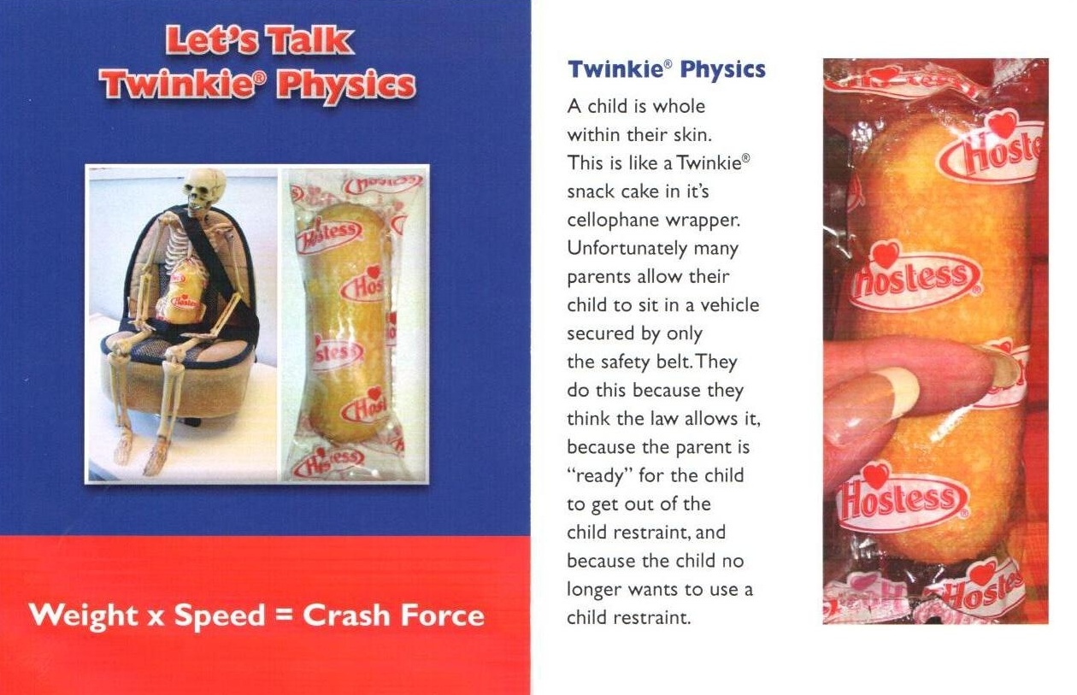
Twinkie Physics
Notes:
Twinkie Physics demonstrates what is known as seat belt syndrome. A child is whole within their skin. This is like a Twinkie snack cake is its cellophane wrapper. Unfortunately many parents allow their child to sit in a vehicle secured by only the safety belt. The do this bvecause they think the law allows it. While a person may not look hurt, they may have internal injuries that can’t be seen. These injuries occur when seat belts are used improperly.

Slide 14
Types of Crashes
From the Front (most common)
From the Side
From the Back (rear-end)
Vehicle Rollover
Notes:
There are four types of crashes. Certain injuries are common in each type of crash if the people are not belted in.
1. From the Front:
In this type of crash, people often have broken bones, cuts, and internal injuries. Crashes from the front happen more than any other type.
2. From the Side:
In this type of crash, people’s heads may hit the window or the door post. They are also likely to have chest and pelvic injuries, broken bones in their faces or heads, and cuts. Crashes from the side don’t happen as often as those from the front but the people in the vehicle are more likely to be killed.
3. From the back:
In this type of crash, people’s necks are often hurt. The bones may break or the soft tissue, like tendons, can tear or stretch. People often have “whiplash” if there is no head restraint or if it is set in the wrong position.
4. Vehicle rollover:
In this kind of crash, the vehicle can roll onto its side or can roll upside down. The more times the vehicle rolls, the more damage is done. The people in the vehicle are often thrown out and crushed.

Slide 15
Injuries Without a Crash
Skids, spins, swerves or sudden braking
Common causes of occupant injuries:
  Thrown out of windows or doors
  Collided with other occupants
  Hits the inside of the vehicle
Notes:
Sometimes people get hurt even when there isn’t a crash. When the driver skids or stops too quickly, people can be thrown out of the vehicle or can be thrown around inside the vehicle. And if a door is not locked, someone may fall out.

Slide 16
How Restraints Prevent Injuries
Keep people in the vehicle
Holds you where your body is strongest
Spreads out the force of the crash
Helps the body to slow down
Protects the head and spine
Notes:
Keeps people from being thrown out
People thrown from a vehicle are four times more likely to be killed than those who remain inside.
Holds you where your body is strongest
For an older child or adult, the shoulders and hips are the strongest. For a baby, the CR supports the whole body.
Spreads out the force of the crash
A lap/shoulder belt, like a CR harness, spreads the force across a large area of the body. This means the person is less likely to get hurt.
Lets the body or CR slow down with the vehicle
This extends the time when the forces are felt by the person during a crash but only if they are held snug against it by a restraint. They are less likely to be hurt if they can slow down with the vehicle.
Protects the head and spinal cord
A shoulder belt or CR harness helps to keep the head and upper body away from the hard inside of the vehicle. But they only work if they fit right.

Slide 17
Best Practice and Tough Choices
Best practice
  Explain best practice options
Tough Choices
  No clear answer
Give options
Seat belts for everyone
  Pickup trucks
  Community vehicles
Use a CR
Tough choices are always made by the parent/caregiver
Notes:
As you learn, practice and explain you will need to keep a couple of things in mind: Best Practice and Tough Choices.
Best practice is the gold standard of protection. It is the most acceptable way to transport a child safely on the basis of the child’s age, weight, height, and body development.
Often, parents/caregivers do not choose the best practice because they do not understand the reason for it. It is your job to understand the reason and explain it to them in clear and simple terms.
Example: Many parents will think that their 5 year old is too big for a “car seat”. Best practice for a 5-9 year-old child is to use a booster seat with a lap/shoulder belt in the vehicle.
Tough choices are made when there may not be a clear answer for the safest way to transport a child. Parent/caregivers will then need to decide among the options.
In many cases, there will be best practices related to the tough choices. You must provide parent/caregivers with available options. Then they can make the tough choices about how best to restrain their own child.
Example: Where do you put three children and a driver in a single cab pick-up truck that has three seatbelts?
Some options:
● Use a different vehicle with more seating,
● leave the children at home or,
● tell the parent/caregiver “I can’t tell you a safe way to do this”.
TOUGH CHOICES ARE ALWAYS MADE BY THE PARENT/CAREGIVER

Slide 18
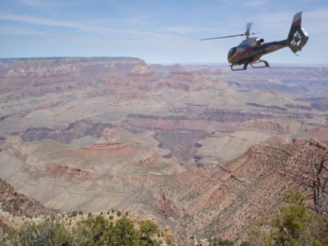
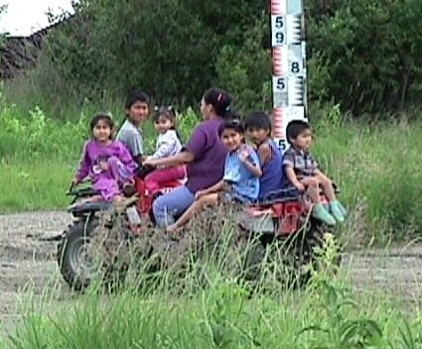
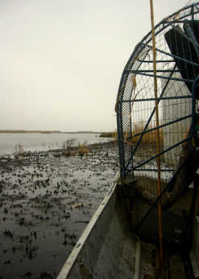
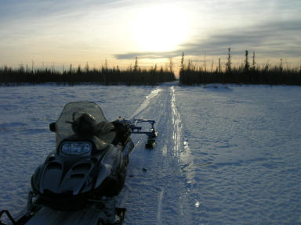
Tough Choices
Vehicles not designed for CR
Off road vehicles (ATV’s)
Snow mobiles
Fan/Air boats
Small aircraft
Safer choices
Use another vehicle
Limit travel time
Check on the child
CR not approved for off road vehicles
Notes:
Some Native American communities are faced with a tough choice when transporting children.
Sometimes their only option is to use vehicles that are not designed for CR.
Off road vehicles such as ATV’s, snow mobiles, fan/air boats and small aircraft are often used by Native Americans that don’t have a road system or live in an isolated area.
In these situations, there may not be a safe option to use a CR.
Safer choices may be:
● Use another vehicle
● Limit the amount of travel time and use the proper safety equipment (i.e. helmets)
● Frequently check to make sure the child is okay
No CR manufacturer approves their CR to be installed in vehicles that are not designed for CR

Slide 19
Thank you!
Please continue on to Part 2 of this session.
Notes:
Ok, this concludes part 1 of the Law Enforcement Training session. It gave you an overview of Crash dynamics and why car seats and seat belts help keep children secure in a vehicle.
. When you’re ready, please continue with part 2, which gives information about different types of child restraints.

